Slide 1

Statistics for Data Science
Wycliffe Bosire

Slide 2


Outline
Linear Algebra and Statistics Basics
Algorithmic framework and structures
Why SQL and Python?
Statistical analysis and data visualization

Slide 3

Introduction
Data Science is a multidisciplinary field which borrows heavily from statistical concepts reflected throughout its structure. From data preprocessing to inferencing data, Statistics plays a major role to help Data Analysts and Scientists to obtain hidden insights in data. In this course, you’ll learn more about Statistical concepts in its raw form and why we need them in Data Science

Slide 4
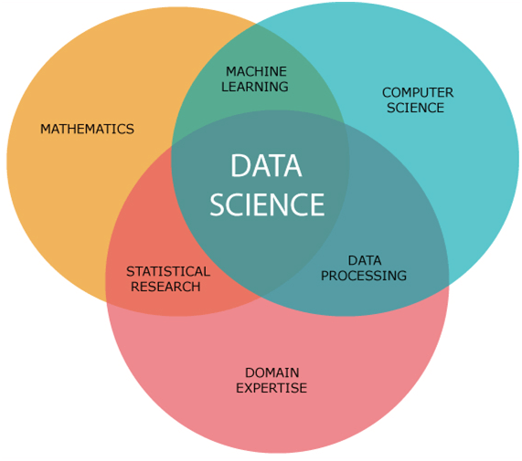
Data Science Fundamentals

Slide 5



Linear Algebra and Statistics Basics
Linear Algebra and Statistics in summary

Slide 6
Linear Algebra
The key takeaway in Linear Algebra is learning about variables, matrices and data visualization.
A variable is a representative of a given value in layman's language.
Many times you’ll end up dealing with independent and target variables. An independent variable is mostly a factor that influences the dependent variable (effect).

Slide 7

Linear Algebra
Imagine a case of a farmer planting crops during the rainy season. The farmer may want to know the factors that affect the yield of his crops. The factors may include, amount of rainfall, fertilizer utilized, size of land etc. In this case, the factors are the independent variables while the yield is the dependent variable in this case.

Slide 8

Linear Algebra
Matrices represent a fundamental concept in Statistics, as they are data structures that store data in forms of rows and columns. Many algorithms like Xgboost store their data in matrix form enabling faster computation. Think of them as how you work with an Excel spreadsheet.
In models like Artificial Neural Networks, matrices store weights which are the parameters that help a neural network make predictions.

Slide 9

You can't fix by analysis what you bungled by design.
Light, Singer and Willett

Slide 10
Statistics Basics
Descriptive Statistics
Inferential Statistics
Descriptive Statistics typically involves data exploration and analysis i.e., understanding the characteristics of a dataset
The measure aspects include measures of central tendency (mean, median and mode) and measures of dispersion (range, variance and standard deviation)
Descriptive Statistics is mostly used by analysts to summarize data and explain the data at hand.
Inferential Statistics goes beyond just summarizing data and mostly revolves around making predictions and analyze sample data to draw conclusions on the entire population
This is what distinguishes a data scientist and a data analyst as a data scientist at this point now carries experiments using aspects like hypothesis testing, estimate parameters and determining confidence levels to make predictions on the population based on sample data

Slide 11

Descriptive Statistics
In measures of central tendency, one of the most popular metrics we know is mean, which is usually the average value of all variables in a feature/column. Many a times we might find our datasets to be skewed either to the left or to the right.
Skewness refers to how we measure distortion in our dataset, either to the left or the right. This highly affects our mean and we might end up dropping the mean in favor of the median (the middle score in a dataset). This is because median is rarely affected by outliers in the dataset
This technique is highly popular when filling null values.

Slide 12
Descriptive Statistics
Measures of dispersion measure how the data is spread in our dataset. The most common ones are Range (Maximum number – Minimum number), Variance (Measure of spread of numbers), and Standard deviation (measure of dispersed data in relation to the mean)
All this can be accessed using the describe function in Python.

Slide 13
Applications of Descriptive Statistics
Using Pandas we assign variables to our datasets. We also assign our features “X and y” before we perform a train test split.
When using Standard Scaler function by Scikit-learn, we aim to normalize our dataset to have a mean of 0 and a unit variance. Why is this important you may ask?
The function is based on the theory that the dataset's variables whose values lie in different ranges do not have an equal contribution to the model's fit parameters and training function and may even lead to bias in the predictions made with that model.

Slide 14

Applications of Descriptive Statistics
In data visualization, you may want to identify the distribution in your data and if you may need to remove outliers in your dataset. With the aid of graphs such as boxplots and histograms, you will be able to identify features which are well distributed for further analysis
One major contribution of visualization before inferencing is building a correlation matrix. The matrix helps us understand feature importance and even feature selection as we look out for features that heavily influence our target variable as well as multicollinearity i.e., features that regress against each other that hence need to be dropped for good model performance

Slide 15
Reports that say that something hasn't happened are always interesting to me, because as we know, there are known knowns; there are things we know we know. We also know there are known unknowns; that is to say we know there are some things we do not know. But there are also unknown unknowns- the ones we don't know we don't know.
Donald Rumsfeld

Slide 16
Algorithmic frameworks and Inferential Statistics
The ability to predict using data

Slide 17
Regression
This type of ML technique is mostly used to show the relationship between the dependent variable and the independent variables.
The most common technique is linear regression, which assumes there’s a linear relationship between the variables.
There are non-linear regression techniques as well. However, they are not commonly used and most times they can be linearized and this brings us back to linear regression.

Slide 18
Classification
In this type of ML algorithm, the main aim is to ensure that your models get to learn from already defined labels and categorize new data based on the labels.
Depending on the complexity of the model, some common algorithms include Logistic Regression, Decision Trees, KNNs, Support Vector Matrix, Random Forest etc

Slide 19
Tree-Based Algorithms
These algorithms are designed in a hierarchical style structure that splits the data based on the values of the features. They are then assigned labels for each leaf/terminal node of the tree.
The most popular are Decision Trees, Random Forest and Gradient Boosting algorithms like XGBoost, Catboost, Adaboost etc

Slide 20
Linear models
As mentioned earlier, linear models assume the relationship between the features are linear by default, and more often used because of its simplicity. They include linear regression, logistic regression and multinomial logistic regression.
The models are easy to build and perform straightforward regression and classification tasks as well as multiclass classification tasks.
The limitation is that they cannot handle complex, non-linear data, but they can be used as baseline models before employing other models to solve the task at hand

Slide 21




Summary
A data scientist knows when it is important for them to step up and give meaning to a world that seems quite unpredictable. Holding the power to predict poses such a significance difference in whatever you do, and this in turn gives you the leverage to drive business and civilization as a whole.

Slide 22


Thank you
Wycliffe Bosire
bosayaw@gmail.com
+254702760150

